Slide 1
Chapter 6
Data Encryption Standard (DES)
6.<number>

Slide 2
Chapter 6
Objectives
❏ To review a short history of DES
❏ To define the basic structure of DES
❏ To describe the details of building elements of DES
❏ To describe the round keys generation process
❏ To analyze DES
6.<number>

Slide 3
Block vs Stream Ciphers
block ciphers process messages in into blocks, each of which is then en/decrypted.
like a substitution on very big characters
  64-bits or more
stream ciphers process messages a bit or byte at a time when en/decrypting
many current ciphers are block ciphers
hence are focus of course
6.<number>

Slide 4
6-1 INTRODUCTION
Data Encryption Standard (DES)
is a symmetric-key block cipher
published by the
  National Institute of Standards and Technology (NIST).
Topics discussed in this section:
6.1.1 History
6.1.2 Overview
6.<number>

Slide 5
6.1.1 History
In 1973, NIST published a request for proposals for a national symmetric-key cryptosystem.
A proposal from IBM, a modification of a project called Lucifer, was accepted as DES.
DES was published in the Federal Register in March 1975 as a draft of the Federal Information Processing Standard (FIPS).
6.<number>

Slide 6
Simplified DES
    an educational algorithm rather than a secure algorithm.
Involves five functions:
  An initial permutation (IP).
  A complex function labeled fk, which involves both permutation and substitution operations and depends on a key input.
  A simple permutation function that switches (SW) the two halves of the data.
  The function fk applied again.
  A permutation function that is the inverse of the initial permutation (IP⁻¹).
6.<number>

Slide 7
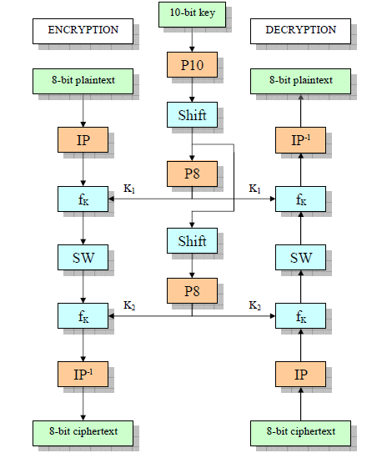
S-DES
6.<number>

Slide 8

Simplified DES
We can express encryption algorithm as superposition:
or
Ciphertext=
And the
S-DES Key Generation:
S-DES depends on the use of a 10-bit key shared between sender and receiver.
From this key, two 8-bit subkeys are produced for use in particular stages of the encryption and
decryption algorithm.
  K₁ = P8(Shift(P10(key))
  K₂ = P8(Shift(Shift(P10(key)))
6.<number>

Slide 9
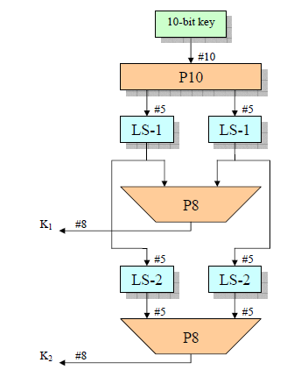


S-DES Key Generation
First, permute the key in the following fashion
Key - 1010000010
Step 1: For example, the key (1010000010) is permuted to (1000001100).
Step 2: Divide (1000001100) into a left part 5-bit value (10000) and a right part 5-bit
value (01100).
Step 3: Perform a circular left shift (LS-1), or rotation, separately. The left value (10000) becomes (00001). The right value (01100) becomes (11000). Concatenate the left part (00001) and the right part (11000) into a 10-bit value (0000111000).
Step 4: Pick out and permutes 8, (don’t use 1 and 2), of the 10 bits according to the
following rules:
6.<number>

Slide 10
Continued.
The result is subkey k1. The value (00 00111000) becomes:
k1 = (10100100).
Step 5: Go back to the pair of 5-bit strings produced by the two LS-1 functions, the results of step 3, and perform a circular left shift of 2 bit positions on each string. The left value (00001) becomes (00100) and the right value (11000) becomes (00011).
Concatenate the left part (00100) and the right part (00011) into a 10-bit value (0010000011).
Step 6: Finally, P8 is applied again to produce k2, the value (00 10000011) becomes:
k2 = (01000011).
6.<number>

Slide 11
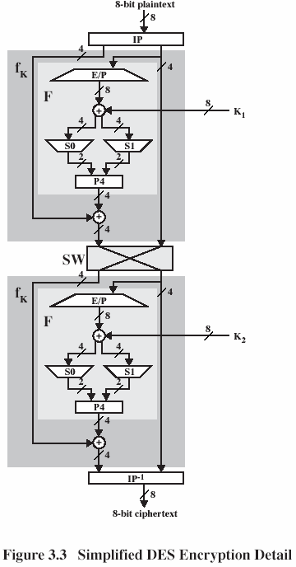
S-DES
ENCRYPTION/ DECRYPTION DETAILS
Example:
key = [1010000010]
plaintext
= [01000001]
= A (char)
ciphertext
= [00010101]
= 15 (hex)
6.<number>

Slide 12


Initial and Final Permutations
    The input to the algorithm is an 8-bit block of plaintext (10111101), which we first permute using the IP function.
Step first: Permute the plaintext (10111101) with IP and the value becomes (01111110).
Step last: Permute the value (11101100) with IP⁻¹ and the ciphertext becomes (01110101).
It is easy to show by example that the second permutation is indeed the reverse of the
first; that is, IP⁻¹(IP(X)) = X.
6.<number>

Slide 13
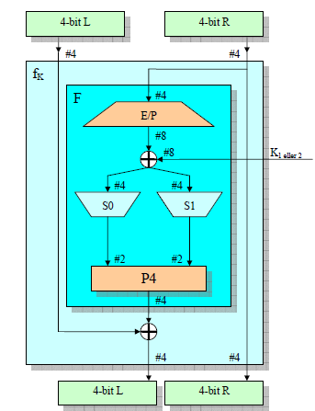
Details of one Round
Step one:
Divide the value into two parts.
The left part becomes (0111) and the right part becomes (1110).
0111 1110
6.<number>

Slide 14

The Function F and f_{k}
The most complex component of S-DES is the function f_{k}, which consists of a combination of permutation and substitution functions
E/P:Expantion/Permutation
Step 2:
Permute using E/P, the Right half(1110) and we have (01111101).
6.<number>

Slide 15



The XOR
Step 3:
Create a matrix based on the result of step 2.
Row 1 is (0111). Row 2 is (1101).
Step 4:
Create a matrix based on the 8-bit subkey
K1 = (k11, k12, k13, k14, k15, k16, k17,k18).
We use the key (1 0 1 0 0 1 0 0).
Step 5:Perform an exclusive-OR function on the matrix in step 3 and step 4.
6.<number>

Slide 16

The XOR Continued.
Step 6:
Rename the result of matrix in step 5. Create groups according to these roles:
(P_{0,0} P_{0,3}), (P_{0,1} P_{0,2}), (P_{1,0} P_{1,3}) and (P_{1,1} P_{1,2}). Convert the binary value to decimal.
(P_{0,0} P_{0,3}) = (11) = 3
(P_{0,1} P_{0,2}) = (10) = 2
(P_{1,0} P_{1,3}) = (11) = 3
(P_{1,1} P_{1,2}) = (00) = 0
6.<number>

Slide 17


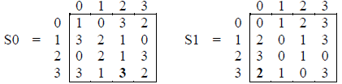
S-boxes
Step 8: The S-boxes operate as follows. The first and fourth input bits are treated as a 2-bit number that specify a row of the S-box, and the second and third input bits specify a column of the S-box. The entry in that row and column, in base 2, is the 2-bit row 0,column 2 of S0, which is 3, or (11) in binary. Add the two 2-bit results into a one 4-bit value.
6.<number>

Slide 18

Continued
Step 8:
Permute the value (1110) which becomes (1011) using P4.
Step 9:
Take the left value from step 1 (0111) and exclusive-OR the value from step 9 (1011).
(0111) ⊕ (1011) = (1100).
Step 10:
Take the value from step 10 (1100) and the right value from step 1 (1110).
6.<number>

Slide 19
The Switch Function
Take the value from step 9 (1100) and the right 4-bit value from IP (1110).
Swap places with each other.
Use (1110) as input to the left side in the f_{k} in the second
Round.
Use (1100) as input to the right side in the f_{k} in the second Round.
SW
6.<number>

Slide 20
Continued
Follow the above steps and continue with the second round of operations.
At end IP⁻¹ is applied again to find the ciphertext
key = [1010000010]
plaintext = [01000001] = A (char)
Ciphertext = [00010101] = 15 (hex)
6.<number>

Slide 21
EXAMPLE:
6.<number>
6.<number>

Slide 22

6.1.2 Overview
DES is a block cipher, as shown in Figure 6.1.
Figure 6.1 Encryption and decryption with DES
6.<number>

Slide 23
6-2 DES STRUCTURE
The encryption process is made of two permutations (P-boxes), which we call initial and final permutations, and sixteen Feistel rounds.
Topics discussed in this section:
6.2.1 Initial and Final Permutations
6.2.2 Rounds
6.2.3 Cipher and Reverse Cipher
6.2.4 Examples
6.<number>

Slide 24

6-2 Continue
Figure 6.2 General structure of DES
6.<number>

Slide 25
DES Key Schedule
forms 16 subkeys, used in each round
consists of:
  A shared secret key of 64 bits
    8,16,24,32,40,48,56,64th bits are parity bits
  initial permutation of the key (PC1) which selects 56-bits in two 28-bit halves
  16 stages consisting of:
    selecting 24-bits from each half
    permuting them by PC2 for use in function f,
    rotating each half separately either 1 or 2 places depending on the key rotation schedule K
6.<number>

Slide 26

6.2.1 Initial and Final Permutations
Figure 6.3 Initial and final permutation steps in DES
6.<number>

Slide 27
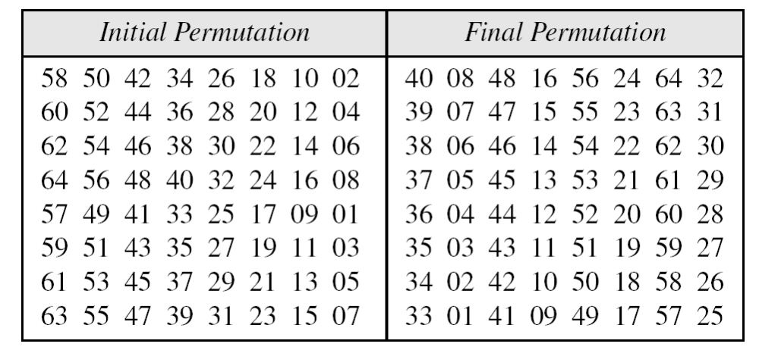
6.2.1 Continue
Table 6.1 Initial and final permutation tables
6.<number>

Slide 28
Initial and final permutation tables
58 50 42 12 64 40 01 15 07
2 3 … 15 25 28 40 63 64
1 2 3 … 15 25 28 40 63 64
40 08 48 63 37 13 29 57 25
6.<number>

Slide 29

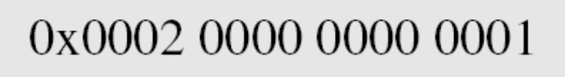
6.2.1 Continued
Example 6.1
Find the output of the initial permutation box when the input is given in hexadecimal as:
Solution:
Only bit 25 and bit 64 are 1s; the other bits are 0s. In the final permutation, bit 25 becomes bit 64 and bit 63 becomes bit 15. The result is
6.<number>

Slide 30
6.2.1 Continued
Example 6.2
Prove that the initial and final permutations are the inverse of each other by finding the output of the final permutation if the input is
Solution
The input has only two 1s; the output must also have only two 1s. Using Table 6.1, we can find the output related to these two bits. Bit 15 in the input becomes bit 63 in the output. Bit 64 in the input becomes bit 25 in the output. So the output has only two 1s, bit 25 and bit 63. The result in hexadecimal is
6.<number>

Slide 31

6.2.1 Continued
Note
The initial and final permutations are straight P-boxes that are inverses
of each other.
They have no cryptography significance in DES.
6.<number>

Slide 32

6.2.2 Rounds
DES uses 16 rounds. Each round of DES is a Feistel cipher.
Figure 6.4
A round in DES
(encryption site)
6.<number>

Slide 33

6.2.2 Continued
DES Function
The heart of DES is the DES function.
The DES function applies a 48-bit key to the rightmost 32 bits to produce a 32-bit output.
Figure 6.5 DES function
6.<number>

Slide 34

6.2.2 Continue
Expansion P-box
Since R_{I−1} is a 32-bit input and K_{I} is a 48-bit key, we first need to expand R_{I−1} to 48 bits.
Figure 6.6 Expansion permutation
6.<number>

Slide 35
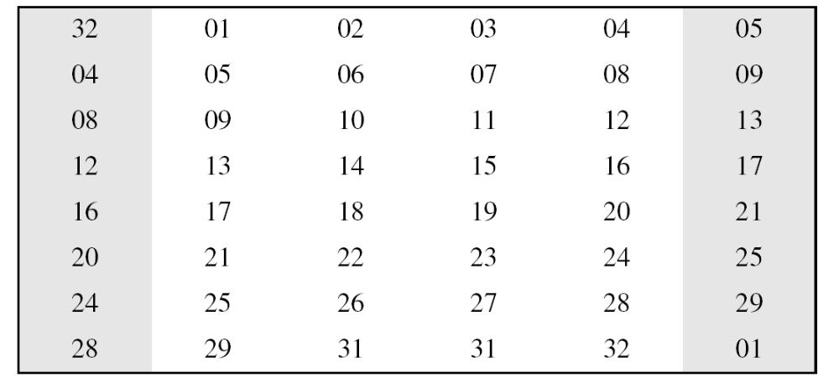
6.2.2 Continue
Although the relationship between the input and output can be defined mathematically, DES uses Table 6.2 to define this P-box.
Table 6.6 Expansion P-box table
6.<number>

Slide 36
6.2.2 Continue
Whitener (XOR)
After the expansion permutation, DES uses the XOR operation on the expanded right section and the round key.
Note that both the right section and the key are 48-bits in length. Also note that the round key is used only in this operation.
6.<number>

Slide 37

6.2.2 Continue
S-Boxes
The S-boxes do the real mixing (confusion). DES uses 8 S-boxes, each with a 6-bit input and a 4-bit output. See Figure 6.7.
Figure 6.7 S-boxes
6.<number>

Slide 38

6.2.2 Continue
Figure 6.8 S-box rule
6.<number>

Slide 39
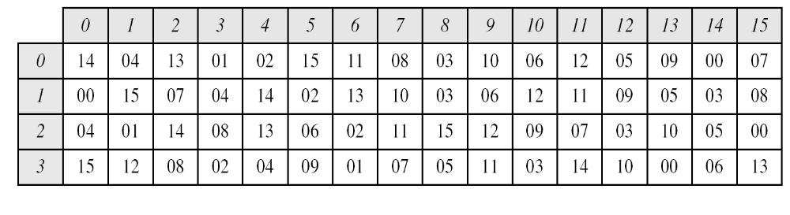
6.2.2 Continue
Table 6.3 shows the permutation for S-box 1. For the rest of the boxes see the textbook.
Table 6.3 S-box 1
Q:The input to S-box 1 is 100011.
What is the output?
6.<number>

Slide 40
6.2.2 Continued
Example 6.3
The input to S-box 1 is 100011. What is the output?
Solution
If we write the first and the sixth bits together, we get 11 in binary, which is 3 in decimal.
The remaining bits are 0001 in binary, which is 1 in decimal.
We look for the value in row 3, column 1, in Table 6.3 (S-box 1). The result is 12 in decimal, which in binary is 1100. So the input 100011 yields the output 1100.
6.<number>

Slide 41
6.2.2 Continued
Example 6.4
The input to S-box 8 is 000000. What is the output?
Solution
If we write the first and the sixth bits together, we get 00 in binary, which is 0 in decimal. The remaining bits are 0000 in binary, which is 0 in decimal. We look for the value in row 0, column 0, in Table 6.10 (S-box 8). The result is 13 in decimal, which is 1101 in binary. So the input 000000 yields the output 1101.
6.<number>

Slide 42
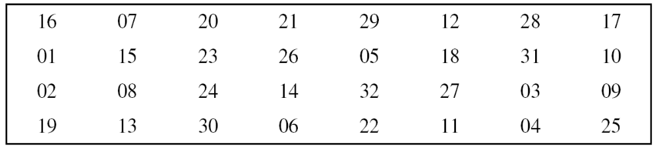
6.2.2 Continue
Straight Permutation
Table 6.11 Straight permutation table
6.<number>

Slide 43
6.2.3 Cipher and Reverse Cipher
Using mixers and swappers, we can create the cipher and reverse cipher, each having 16 rounds.
First Approach
To achieve this goal, one approach is to make the last round (round 16) different from the others; it has only a mixer and no swapper.
Note
In the first approach, there is no swapper in the last round.
6.<number>

Slide 44

Continued
Figure 6.9 DES cipher and reverse cipher for the first approach
6.<number>

Slide 45
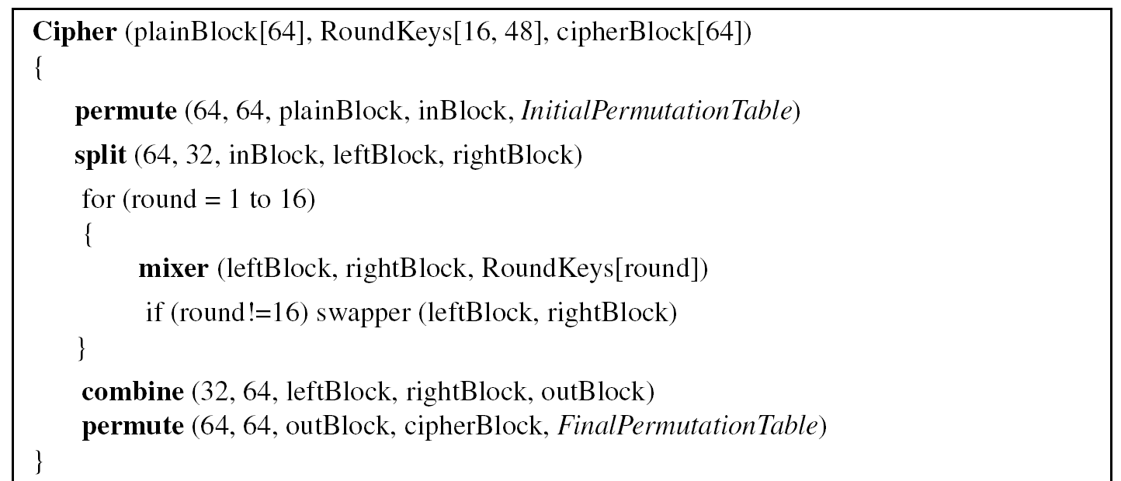
6.2.3 Continued
Algorithm 6.1 Pseudocode for DES cipher
6.<number>

Slide 46
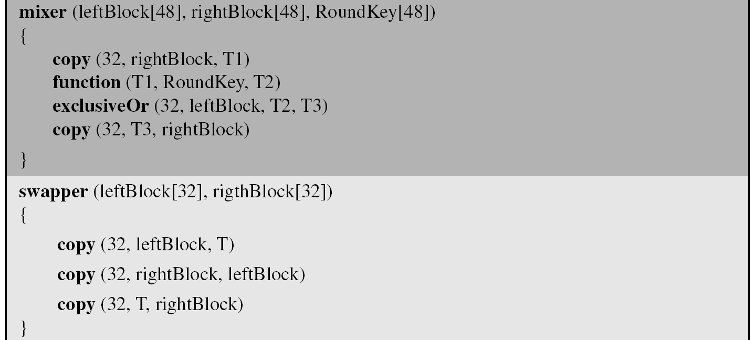
6.2.3 Continued
Algorithm 6.1 Pseudocode for DES cipher (Continued)
6.<number>

Slide 47
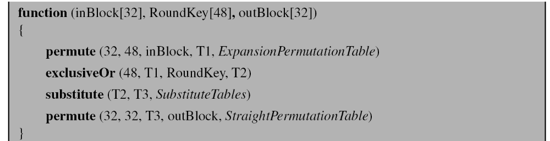
6.2.3 Continued
Algorithm 6.1 Pseudocode for DES cipher (Continued)
6.<number>

Slide 48
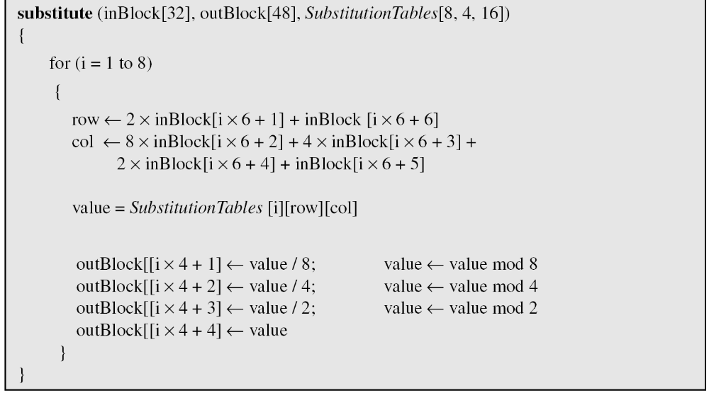
6.2.3 Continued
Algorithm 6.1 Pseudocode for DES cipher (Continued)
6.<number>

Slide 49
6.2.3 Continued
Alternative Approach
We can make all 16 rounds the same by including one swapper to the 16th round and add an extra swapper after that (two swappers cancel the effect of each other).
Key Generation
The round-key generator creates sixteen 48-bit keys out of a 56-bit cipher key.
6.<number>

Slide 50

6.2.3 Continued
Figure 6.10
Key generation
6.<number>

Slide 51
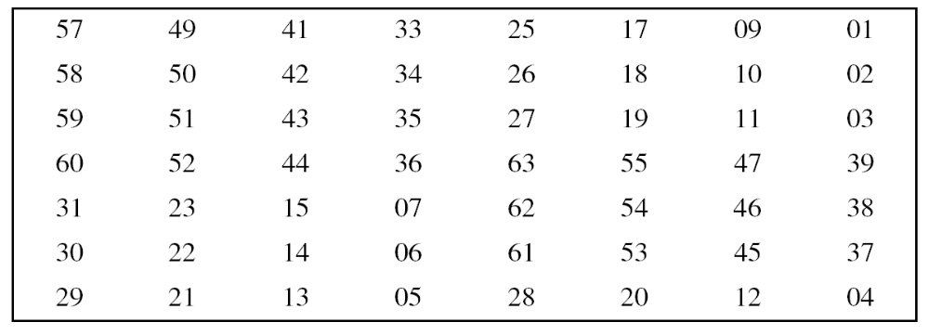
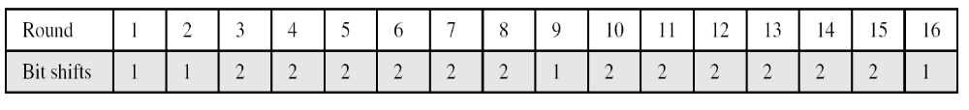
6.2.3 Continued
Table 6.12 Parity-bit drop table
Table 6.13 Number of bits shifts
6.<number>

Slide 52
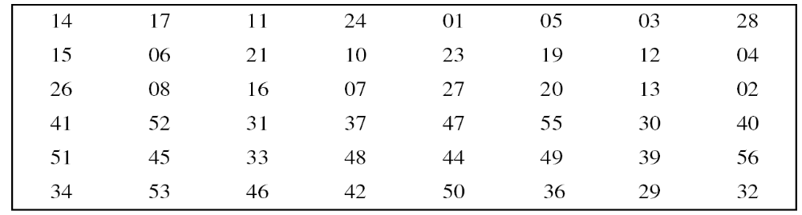
6.2.3 Continued
Table 6.14 Key-compression table
6.<number>

Slide 53
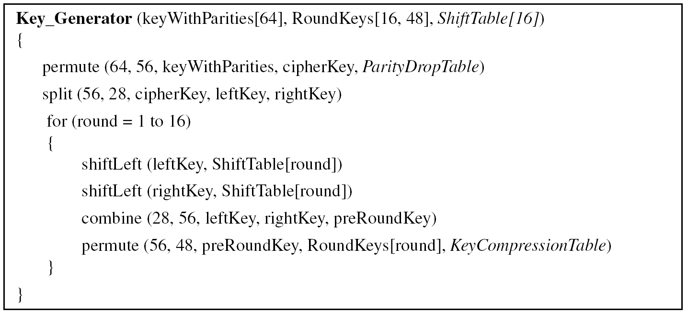
6.2.3 Continued
Algorithm 6.2 Algorithm for round-key generation
6.<number>

Slide 54
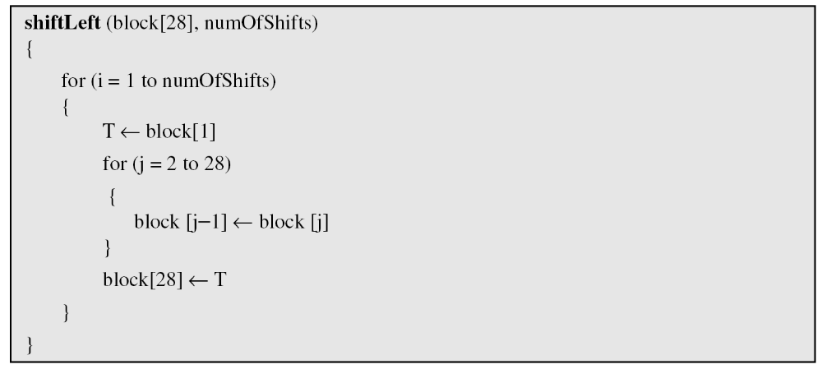
6.2.3 Continued
Algorithm 6.2 Algorithm for round-key generation (Continue)
6.<number>

Slide 55
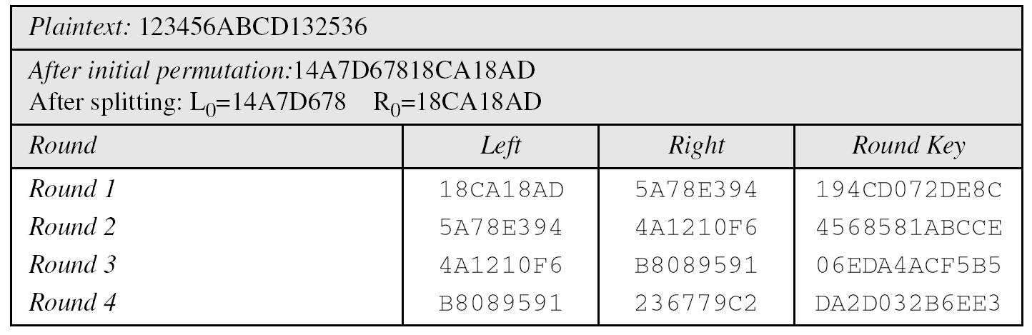
6.2.4 Examples
Example 6.5
We choose a random plaintext block and a random key, and determine what the ciphertext block would be (all in hexadecimal):
Table 6.15 Trace of data for Example 6.5
6.<number>

Slide 56
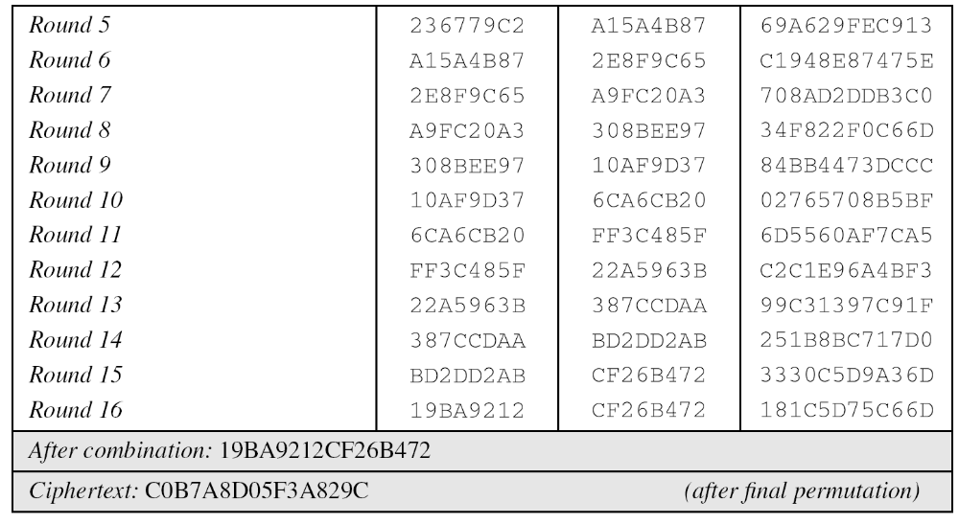
6.2.4 Continued
Example 6.5
Continued
Table 6.15 Trace of data for Example 6.5 (Conintued
6.<number>

Slide 57
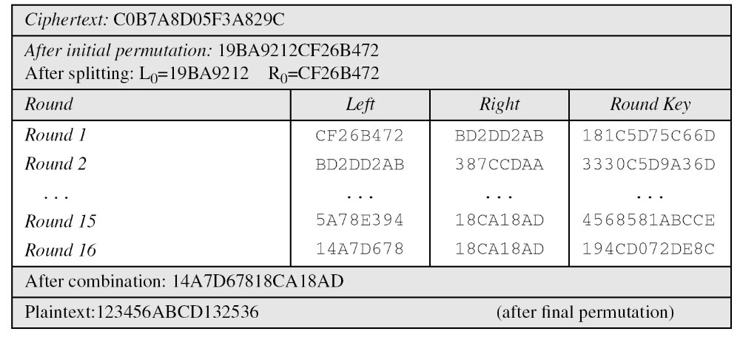
6.2.4 Continued
Example 6.6
Let us see how Bob, at the destination, can decipher the ciphertext received from Alice using the same key. Table 6.16 shows some interesting points.
6.<number>

Slide 58
6-3 DES ANALYSIS
Critics have used a strong magnifier to analyze DES. Tests have been done to measure the strength of some desired properties in a block cipher.
Topics discussed in this section:
6.3.1 Properties
6.3.2 Design Criteria
6.3.3 DES Weaknesses
6.<number>

Slide 59
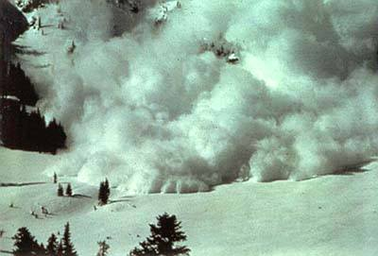
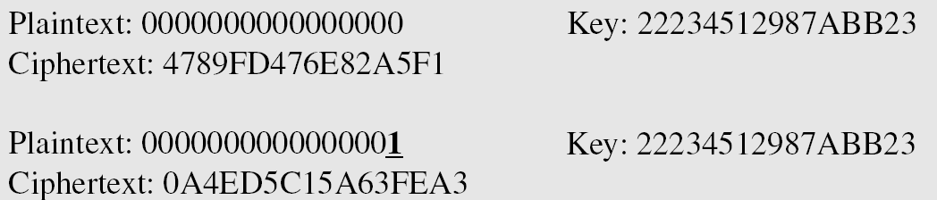
6.3.1 Properties
Two desired properties of a block cipher are the avalanche effect and the completeness.
Example 6.7
To check the avalanche effect in DES, let us encrypt two plaintext blocks (with the same key) that differ only in one bit and observe the differences in the number of bits in each round.
6.<number>

Slide 60
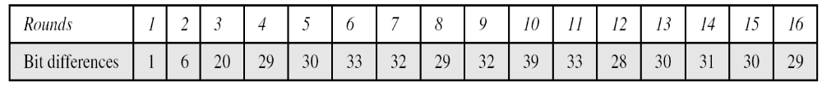
6.3.1 Continued
Example 6.7
Continued
Although the two plaintext blocks differ only in the rightmost bit, the ciphertext blocks differ in 29 bits. This means that changing approximately 1.5 percent of the plaintext creates a
change of approximately 45 percent in the ciphertext.
Table 6.17 Number of bit differences for Example 6.7
6.<number>

Slide 61
6.3.1 Continued
Completeness effect
Completeness effect means
that each bit of the ciphertext needs to depend on many bits on the plaintext.
Ex: result of p-box and S-box.
6.<number>

Slide 62
6.3.2 Design Criteria
S-Boxe
The design provides confusion and diffusion of bits from each round to the next.
P-Boxes
They provide diffusion of bits.
Number of Rounds
DES uses sixteen rounds of Feistel ciphers. the ciphertext is thoroughly a random function of plaintext and ciphertext.
6.<number>

Slide 63
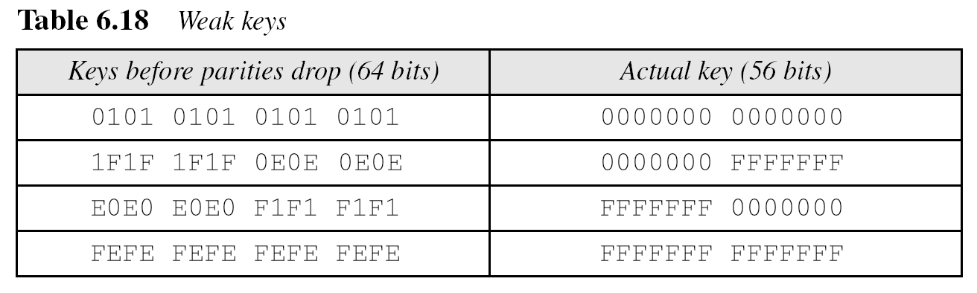
6.3.3 DES Weaknesses
During the last few years critics have found some weaknesses in DES.
Weaknesses in Cipher Design
1. Weaknesses in S-boxes
2. Weaknesses in P-boxes
3. Weaknesses in Key
6.<number>

Slide 64
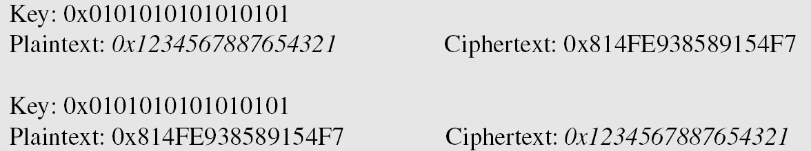
6.3.3 Continued
Example 6.8
Let us try the first weak key in Table 6.18 to encrypt a block two times.
After two encryptions with the same key the original plaintext block is created.
Note that we have used the encryption algorithm two times, not one encryption followed by another decryption.
6.<number>

Slide 65
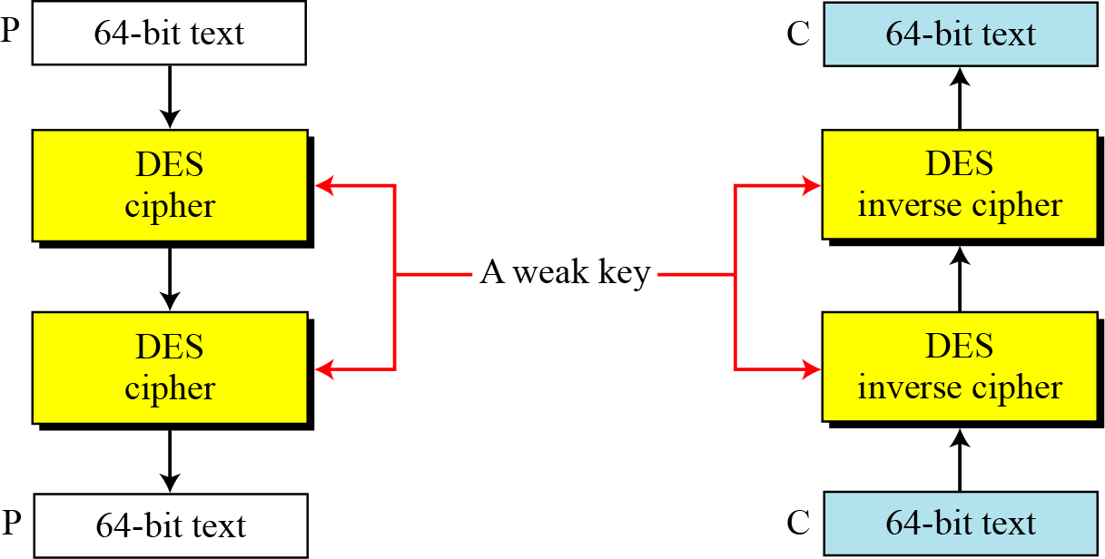
6.3.3 Continued
Figure 6.11 Double encryption and decryption with a weak key
6.<number>

Slide 66
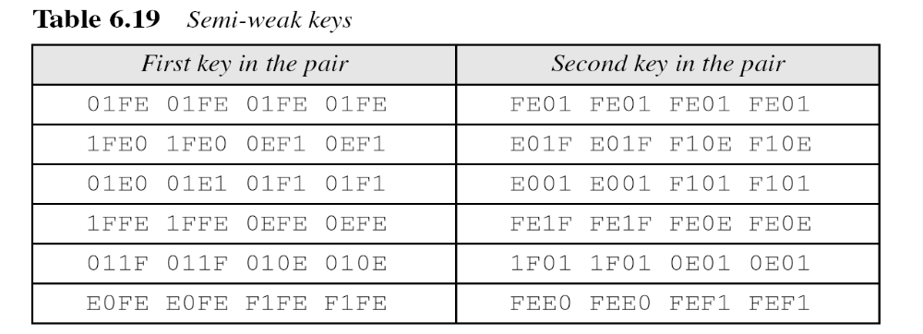
6.3.3 Continued
A semi-weak key creates only two different round keys
6.<number>

Slide 67
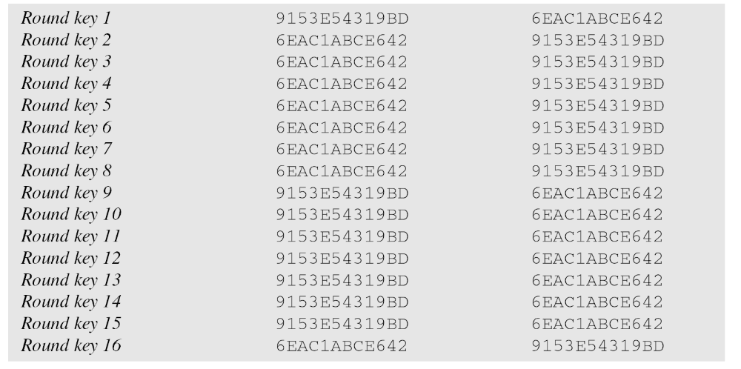
6.3.3 Continued
6.<number>

Slide 68
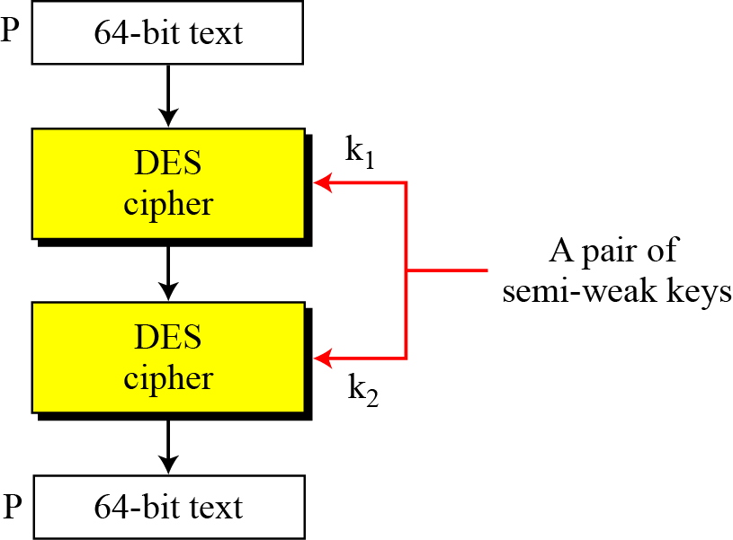
6.3.3 Continued
Figure 6.12 A pair of semi-weak keys in encryption and decryption
6.<number>

Slide 69
6.3.3 Continued
Example 6.9
What is the probability of randomly selecting a weak, a semi-weak, or a possible weak key?
Solution
DES has a key domain of 2⁵⁶. The total number of the above keys are 64 (4 + 12 + 48). The probability of choosing one of these keys is 8.8 × 10⁻¹⁶, almost impossible.
6.<number>

Slide 70
6-4 Multiple DES
The major criticism of DES regards its key length. Fortunately DES is not a group. This means that we can use double or triple DES to increase the key size.
Topics discussed in this section:
6.4.1 Double DES
6.4.4 Triple DES
6.<number>

Slide 71
6.4.1 Double DES
The first approach is to use double DES (2DES).
Ciphertext C = E_{K2}(E_{K1}(P))
Plaintext P = D_{K1}(D_{K2}(C ))
Meet-in-the-Middle Attack
However, using a known-plaintext attack called meet-in-the-middle attack proves that double DES improves this vulnerability slightly (to 2⁵⁷ tests), but not tremendously (to 2¹¹²).
6.<number>

Slide 72
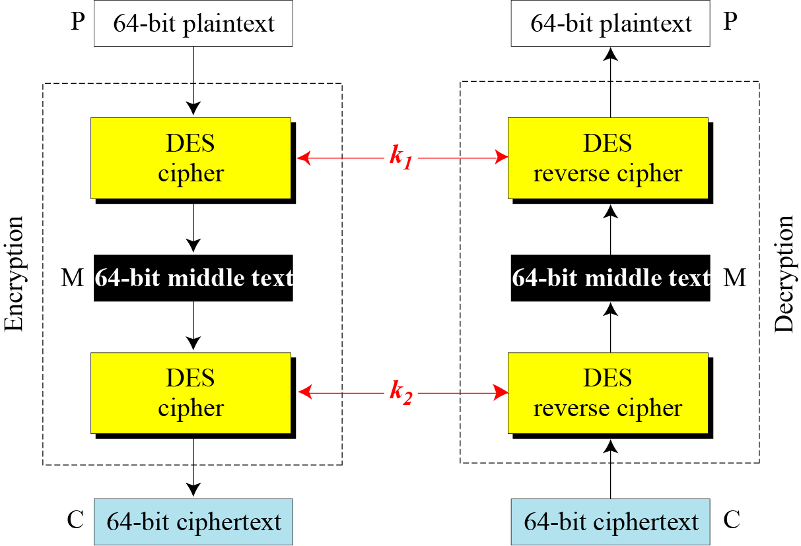
6.4.1 Continued
Figure 6.14 Meet-in-the-middle attack for double DES
6.<number>

Slide 73
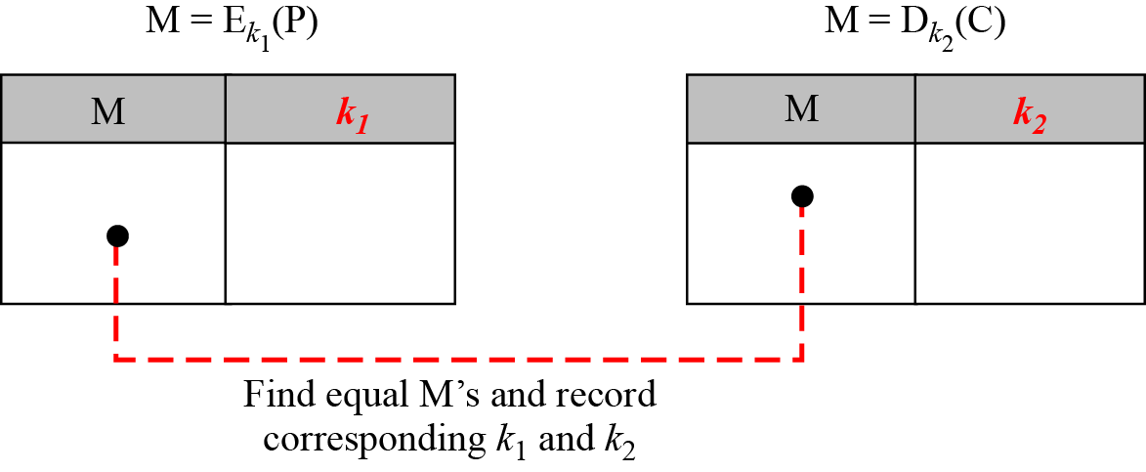
6.4.1 Continued
Figure 6.15 Tables for meet-in-the-middle attack
6.<number>

Slide 74
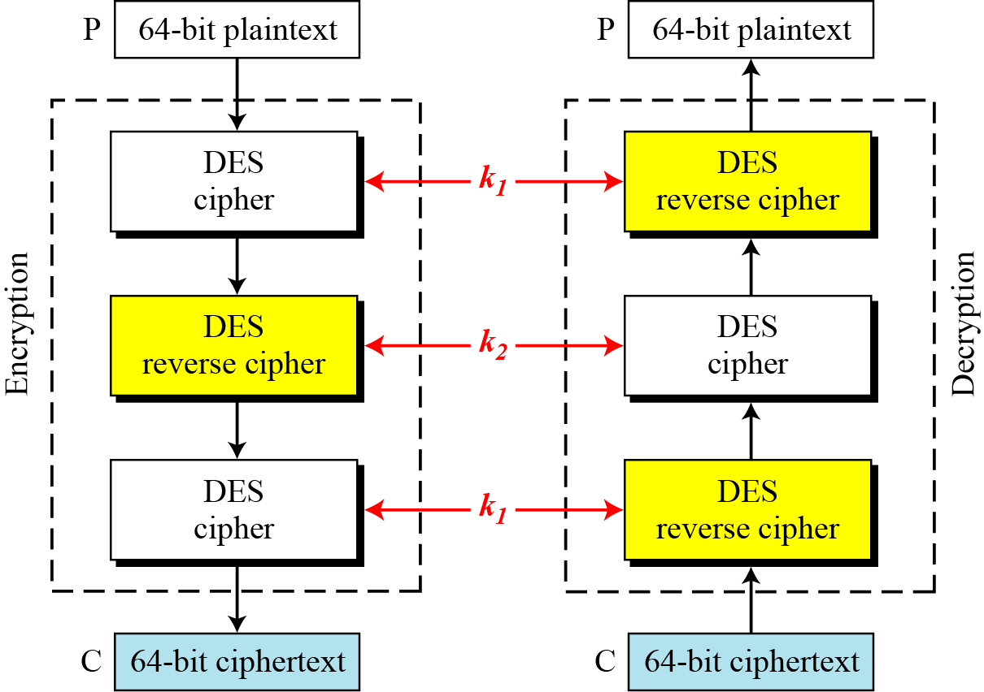
6.4.2 Triple DES
Figure 6.16 Triple DES with two keys
E
D
E
D
E
D
6.<number>

Slide 75
6.4.2 Continuous
Triple DES with Three Keys
The possibility of known-plaintext attacks on triple DES with two keys has enticed some applications to use triple DES with three keys. Triple DES with three keys is used by many applications such as PGP (See Chapter 16, forouzan).
6.<number>

Slide 76
6-5 Security of DES
DES, as the first important block cipher, has gone through much scrutiny. Among the attempted attacks, three are of interest: brute-force, differential cryptanalysis, and linear cryptanalysis.
Topics discussed in this section:
6.5.1 Brute-Force Attack
6.5.2 Differential Cryptanalysis
6.5.3 Linear Cryptanalysis
6.<number>

Slide 77
6.5.1 Brute-Force Attack
We have discussed the weakness of short cipher key in DES. Combining this weakness with the key complement weakness, it is clear that DES can be broken using 2⁵⁵ encryptions.
6.<number>

Slide 78
6.5.2 Differential Cryptanalysis
It has been revealed that the designers of DES already knew about this type of attack and designed S-boxes and chose 16 as the number of rounds to make DES specifically resistant to this type of attack.
Note
We show an example of DES differential cryptanalysis in Appendix N.
6.<number>

Slide 79
6.5.3 Linear Cryptanalysis
Linear cryptanalysis is newer than differential cryptanalysis. DES is more vulnerable to linear cryptanalysis than to differential cryptanalysis. S-boxes are not very resistant to linear cryptanalysis. It has been shown that DES can be broken using 2⁴³ pairs of known plaintexts. However, from the practical point of view, finding so many pairs is very unlikely.
Note
We show an example of DES linear cryptanalysis in Appendix N.
6.<number>

